Slide 1

Arabic Verb conjugation: person and number
تَصْرِيْفُ الفِعْلِ حَسَبُ الشَّخْصِ وَالعَدَدِ

Slide 2

أَفْعَلُ
Af3alu

Slide 3
أَ فْ عَ لُ
Lu
3A
F
A

Slide 4
أَفْعَلُ
Af3alu

Slide 5
أَفْعَلُ
Af3alu
I Do

Slide 6
أَفْعَلُ
Af3alu
I Do

Slide 7

أ
فْعَلُ
Verb Stem
(root)
Person Prefix

Slide 8
Verb Stem (root)
Person Prefix
أ
أَفْعَلُ
فْعَلُ
(I Do)
f3alu
A

Slide 9
تَفْعَلُ
Taf3alu
Meaning: You (M.) Do
Prefix: تَ

Slide 10
Verb Stem (root)
Person Prefix
تَ
تَفْعَلُ
فْعَلُ
Ta
(You M. Do)
f3alu

Slide 11
تَفْعَلِيْنَ
Taf3alu
Meaning: You (F.) Do
)Prefix: تَ
،Suffix: (يْنَ

Slide 12
Person Suffix
Verb Stem
(root)
Person
Prefix
يْنَ
فْعَلِ
تَ
تَفْعَلِيْنَ
(You F. Do)
Ta
iina
f3ali

Slide 13
Arabic Verb conjugation: person and number
تَصْرِيْفُ الفِعْلِ حَسَبُ الشَّخْصِ وَالعَدَدِ

Slide 14
Singular Verb Persons
أَفْعَلُ
I Do
Af3alu
تَفْعَلُ
You M. Do
Taf3alu
Taf3aliina
تَفْعَلِيْنَ
You F. Do
يَفْعَلُ
He Does
Yaf3alu
تَفْعَلُ
She Does
Taf3alu

Slide 15
Plural Verb Persons
نَفْعَلُ
We Do
Naf3alu
تَفْعَلُوْنَ
You M.Pl. Do
Taf3aluuna
You F.Pl. Do
Taf3alna
تَفْعلْنَ
يَفْعَلُوْنَ
They M.Pl Do
Yaf3aluuna
يَفْعَلْنَ
They F.Pl. Do
Yaf3alna

Slide 16
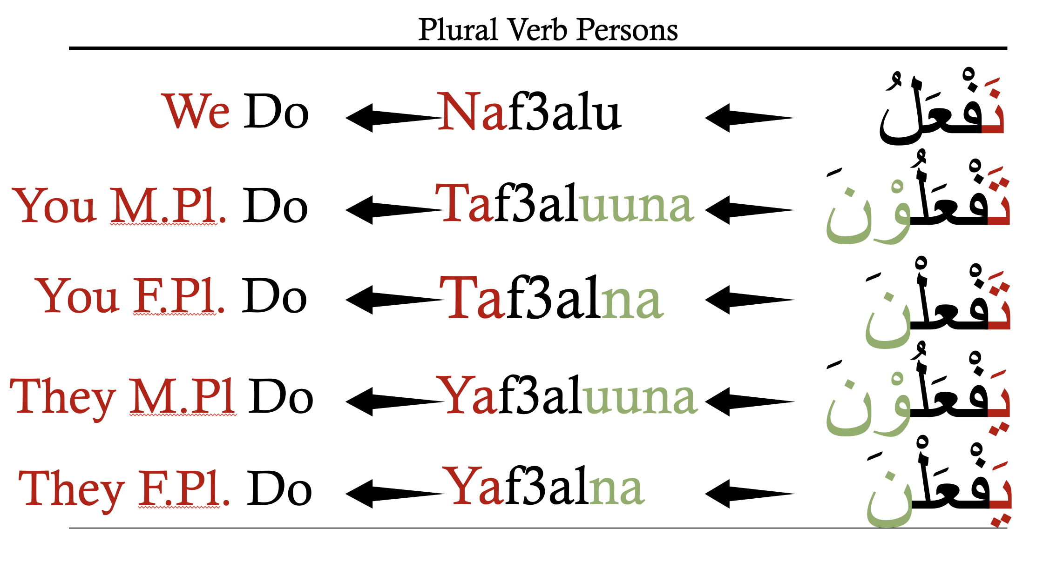
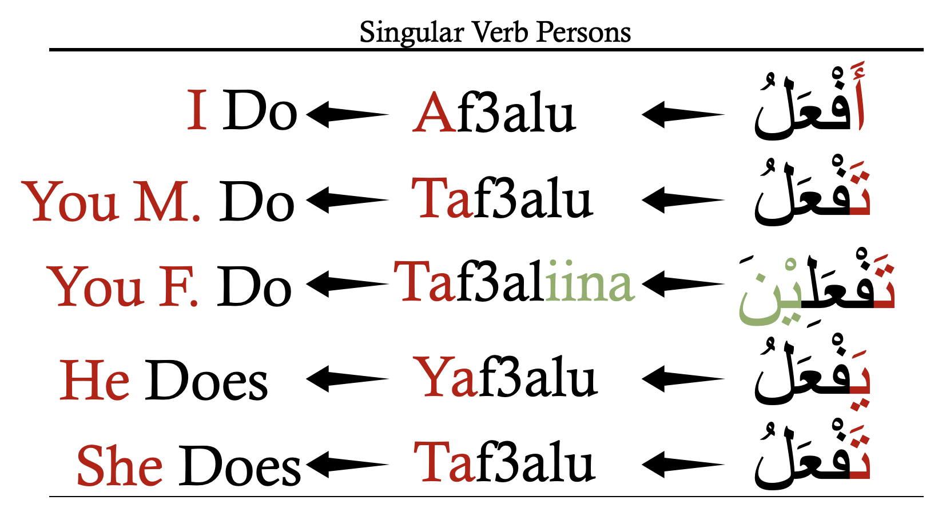
Full Verb Persons Chart

Slide 17
Arabic Verb conjugation:
The past Tense
الفِعْلِ المَاضِي

Slide 18


Singular Verb Persons
فَعَلْتُ
I Did
Fa3altu
فَعَلْتَ
You M. Did
Fa3alta
Fa3alti
فَعَلْتِ
You F. Did
فَعَلَ
He Did
Fa3ala
فَعَلَتْ
She Did
Fa3alat

Slide 19
Plural Verb Persons
فَعَلْنَاْ
We Did
Fa3alnaa
فَعَلْتُمْ
You M.Pl. Did
Fa3altum
You F.Pl. Did
Fa3altunna
فَعَلْتُنَّ
فَعَلُوْا
They M.Pl Did
Fa3aluu
فَعَلْنَ
They F.Pl. Did
Fa3alna

Slide 20
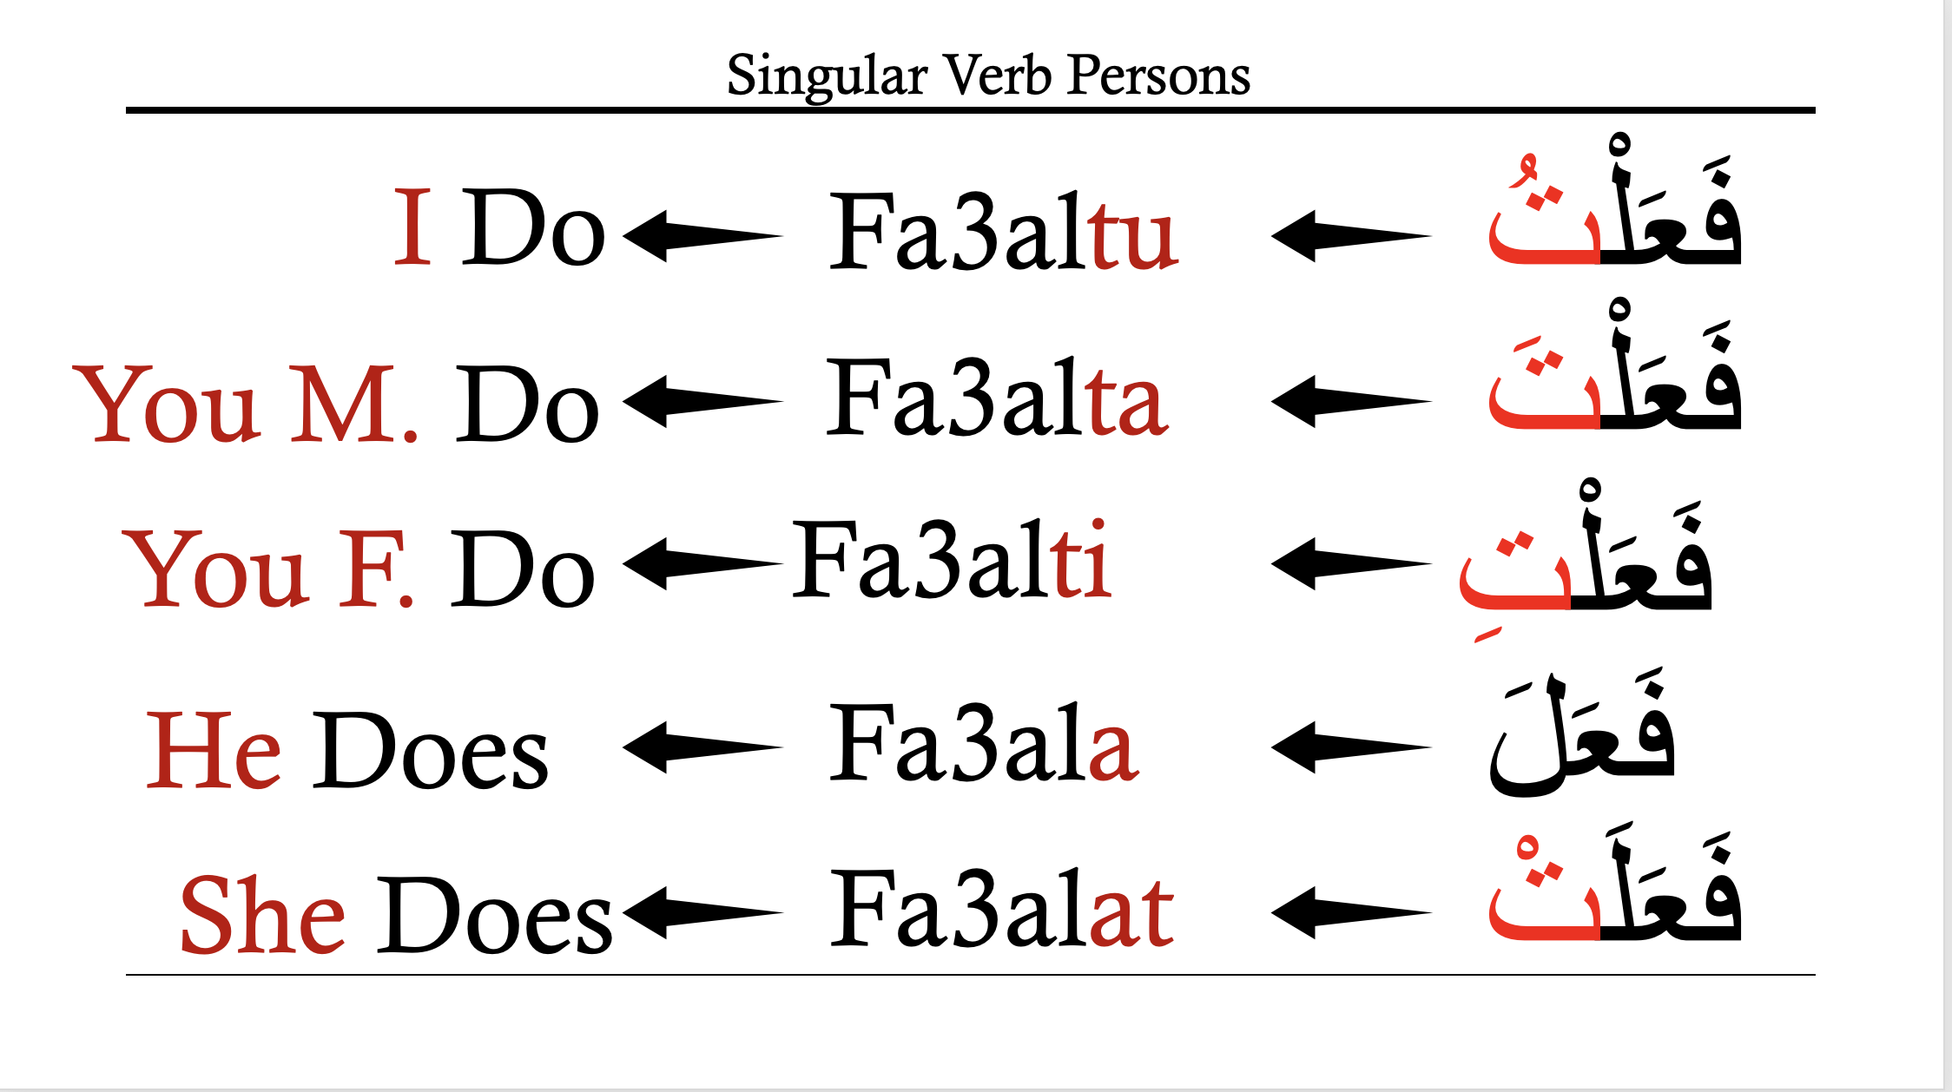
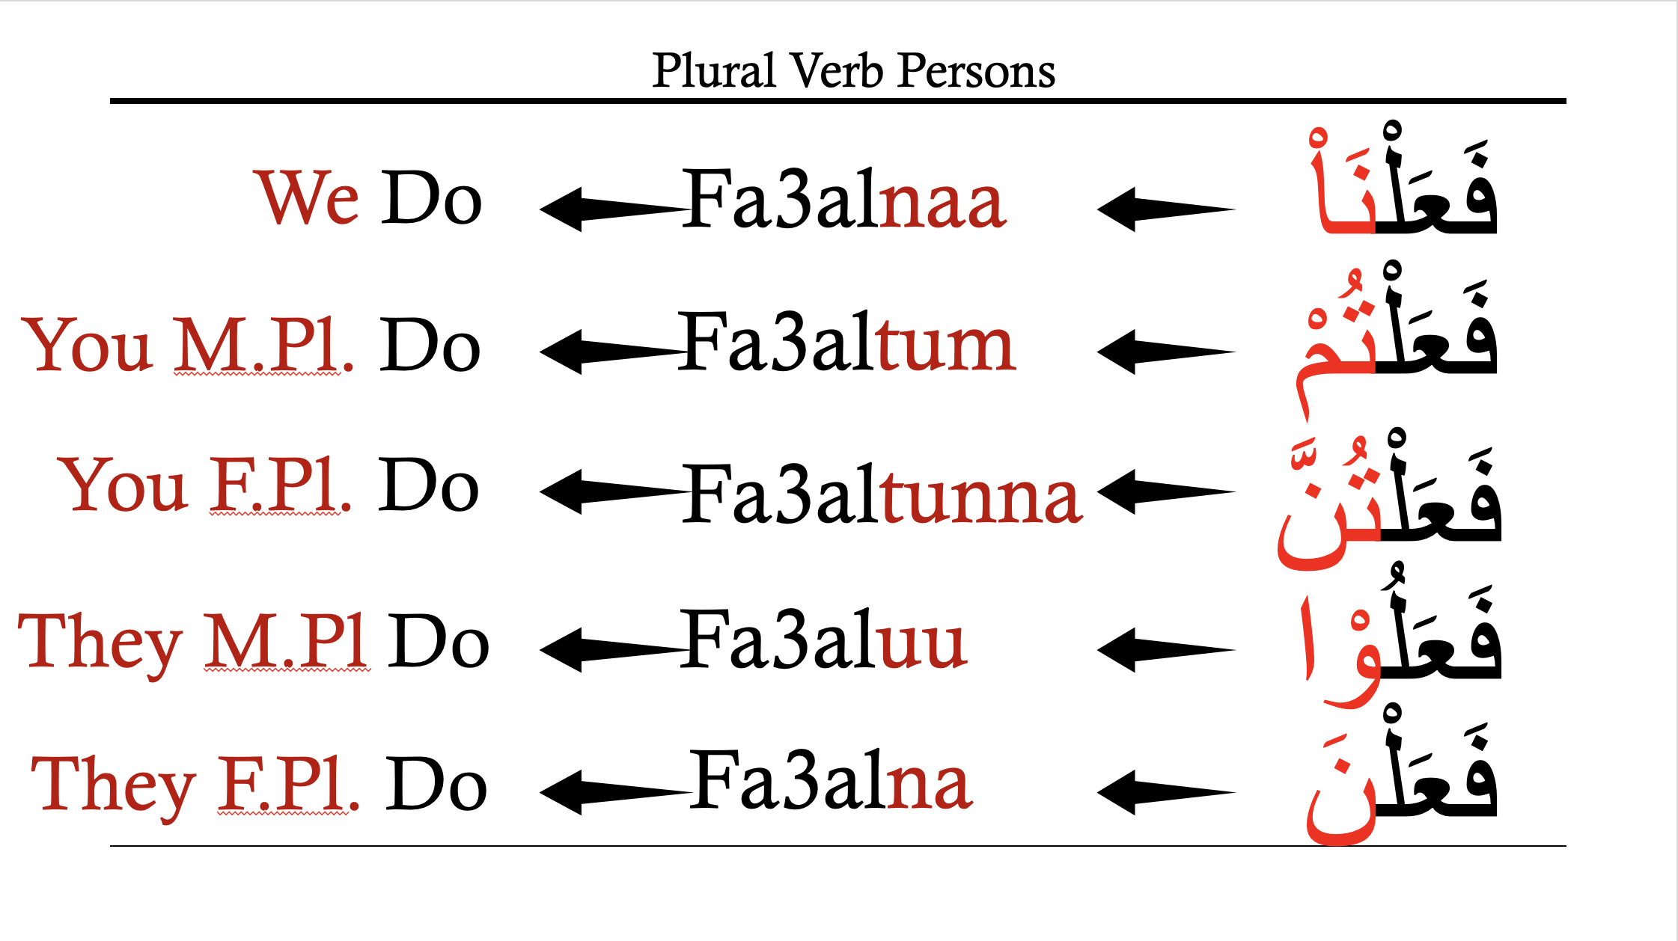
Full Verb Persons Chart – Past Tense

Slide 21
مَعَ سَلَام!

